Slide 1
Building a new data strategy for Aegon Asset Management
Steering Committee Meeting #3
WIP 8 March 2022

Slide 2
Agenda
1. |  | Project Plan & Status Overview
2. |  | Summary of Draft Data Strategy
3. |  | Strategic Data Objectives
4. |  | Data Design Principles
5. |  | Key Use Cases (WIP)
6. |  | Next Steps

Slide 3

Project plan
TODAY
Activities | December 21’ |  | Sprint 1 |  | January 22’ |  |  |  | February 22’ |  |  |  | March 22’
 | 6.12 - 10.12 | 13.12 - 17.12 | 20.12 - 24.12 | 27.12 - 31.12 | 3.1 - 7.1 | 10.1 - 14.1 | 17.1 - 21.1 | 24.1 - 28.1 | 31.1 - 4.2 | 7.2 - 11.2 | 14.2 - 18.2 | 21.2 - 25.2 | 28.2 - 4.3 | 7.3 - 11.3
1. 1 Send a kick-off email, define detailed scope and project plan including governance and request relevant documentation
1.2 Determine stakeholders and change initiative representatives across data teams in Aegon AM and also in Aegon Group, draft a communication plan including the touchpoints with the change initiatives for continuous updates and alignment and schedule the Phase B workshops
1.3 Conduct interviews to understand Aegon’s business strategy including (if any) its innovation objectives, its current data strategy, data challenges and root causes and Aegon Group vision and mission
1.4 Perform a high-level data culture assessment including data awareness, data literacy, data advocacy and data practices
1.5 Conduct a desk research to identify the market trends and data strategies of other asset managers
1.6 Recommend elements of the data strategy
2.1 Organize a knowledge sharing session to reflect on learnings
2.2 Facilitate a (series of) strategy workshop(s) involving the core team and the key stakeholders to answer the key strategy questions
2.3 Draft the new data strategy based on the outcomes and inputs of the workshops and discuss with the core team
3.1 Identify defensive and offensive use cases that create value for business in collaboration with relevant stakeholders from individual functions and business
3.2 Assess the impact of the use cases in terms of commercial, risk, operational efficiency and financial control and also regarding the organizational capabilities and the data foundation
3.3 Organize touchpoints to determine the impact with the other initiatives
3.4 Report on the findings by showing how balanced data control and flexibility brings each use cases including recommendation on prioritization of the use cases
3.5 Draft the roll-out roadmap of the new data strategy
3.6 Facilitate validation workshop to finalize the data strategy
Detailed project plan and governance structure
Communication plan with key stakeholders and the change initiative representatives
Phase A: Onboarding and understanding the current state
Understanding of current state, data challenges and root causes
Desk research on market trends and competitive analysis
Data strategy skeleton including the identified core elements
Knowledge sharing session 7/3
Phase B: Translating strategic objectives into Data strategy
A series of strategy workshops to formulate the new data strategy including objectives, design principles, organizational capabilities and foundation requirements
Draft data strategy
Phase C: Analyzing the impact (Defensive vs Offensive)
Report on impact analysis
Communication plan
Validated and finalized data strategy
Activity duration
Kick-off
SteerCo meeting
Deliverable
Activity requires Aegon stakeholders’ involvement
Initial plan

Slide 4
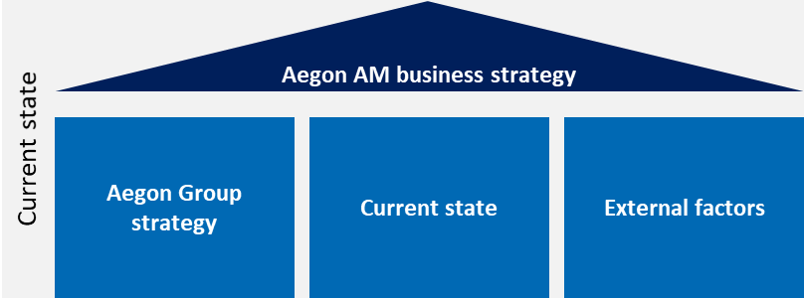

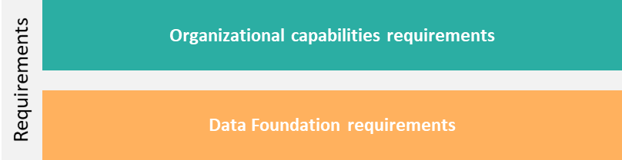
Data strategy
Status of the AAM Data strategy
draft
Data Strategy statement
draft
Strategic data objective 1
Strategic data objective 2
Strategic data objective 3
Strategic data objective 4
Strategic data objective 5
draft
Design principle 1
Design principle 2
Design principle 3
Design principle 4
Design principle 5
Design principle 6
Design principle 7
WIP
Use cases
draft

Slide 5
Data Strategy Summary

Slide 6

AAM Data Strategy Disclaimer
AAM will follow a 2-step approach to excel with the new data strategy.
Data is an enabler at AAM that is driving the client conversations and therefore we first commit to strengthening its foundation while improving the roles and responsibilities to define clear ownerships in order to ensure integrity, accuracy and compliance.
AAM leverages data-driven solutions by enabling advanced analytics in the full value chain to create insights for building better investment products for clients and to drive cost-efficiencies on serving to the clients on the front-line.
Step-1: Reinforced data foundation
Step-2: Data-driven client focus
The AAM Data Strategy will be re-evaluated in 18-24 months.

Slide 7







Data strategy
Summary of the AAM Data strategy
draft
Data Strategy statement
AAM needs a significant investment to catch up to its competitors’ data capabilities in order to realize its business strategy of helping its clients live their best lives by becoming their trusted partner. The shared ambition among AAM business units’ is to get in control and understand what is currently happening in each of the business data domains to move from gut-feel management to data driven decision-making. The first step is to move from the current data silos to a data enterprise incl. a single source of truth for operational and investment data to gain control (trust & access to the relevant data) to free up the capacity to dream about applied analytics in business processes. This will make AAM an attractive employer for knowledge workers scarce in the market. When the foundational work is done, the data strategy should be evaluated and updated to keep on growing and accelerating the use of data & analytics.
draft
#1: Improving Data Governance and integrating Data Management for ensuring and easy/timely data access
#2: Integration of data requirements in one enterprise data model to better serve our clients
#3: Global and consistent reporting for operations
#4: Building a global way of working for innovation and analytics to improve investments and client experience
#5 AAM as preferred Responsible Investment provider
Strategic data
objectives
draft
Commitment to data-driven operations
Data enterprise with one global, integrated data model
Global data management framework
Data ownership as a business responsibility
Simplified and standardized activities by automation
Facilitating and enabling business driven analytics
Holistic approach to utilizing trusted ESG data & analytics
Data design principles
WIP
Use cases
draft
Notes:
Strategy statement
AAM needs a significant investment to catch up to its competitors’ data capabilities in order to realize its business strategy of making responsible investment decisions every day.
The shared ambition among AAM business units’ is to get in control and understand what is currently happening in the firm to move from gut-feel management to data driven decision-making.
The first step is to move from the current data silos to a data enterprise incl. a single source of truth to gain control (trust & access to the relevant data) to free up the capacity to dream about applied analytics in business processes.
This will make AAM an attractive employer for knowledge workers scarce in the market.
When the foundational work is done, the data strategy should be evaluated and updated to keep on growing and accelerating the use of data & analytics.

Slide 8
Data strategy
Extensive Summary of the AAM Data strategy
draft
Data Strategy statement
AAM needs a significant investment to catch up to its competitors’ data capabilities in order to realize its business strategy of helping its clients live their best lives by becoming their trusted partner. The shared ambition among AAM business units’ is to get in control and understand what is currently happening in each of the business data domains to move from gut-feel management to data driven decision-making. The first step is to move from the current data silos to a data enterprise incl. a single source of truth for operational and investment data to gain control (trust & access to the relevant data) to free up the capacity to dream about applied analytics in business processes. This will make AAM an attractive employer for knowledge workers scarce in the market. When the foundational work is done, the data strategy should be evaluated and updated to keep on growing and accelerating the use of data & analytics.
draft
#1 Improving Data Governance and integrating Data Management into our business for ensuring regulatory compliance and easy/timely access to data
#2: Integration of data requirements in one enterprise data model across current and future demands to better serve our clients
#3: Global and consistent reporting for operational management and using data to run the firm by underpinning all decision-making
#4: Building a global way of working in enabling the business to use analytics and data innovation techniques to improve investment decisions and client experience
#5 AAM as user of data-driven technologies to become the preferred Responsible Investment provider
Strategic data
objectives
draft
Data is at the heart of our business and we invest in the organizational and technological enablers to increase our AuM and improve operational excellence
We are a data enterprise with one global, integrated data model providing a unified information view to serve our clients better in everything we do
Our global data management framework provides data quality, privacy and compliance by design and ensures data is always shared in a secured manner
Data ownership is a business responsibility and the data owner is always accountable for data quality
We simplify and standardize our activities by automating data processing (calculate it once, use it by many) where possible in order to enhance first-time right (straight-through-processing) and therefore creating cost efficiencies
We facilitate and enable business driven analytics initiatives with a global way of working and architectural standards
We apply a holistic approach to utilizing trusted ESG data & analytics to engage with our prospects and clients to enable them to make responsible investment decisions
Data design principles
WIP
Use cases
Notes:
Strategy statement
AAM needs a significant investment to catch up to its competitors’ data capabilities in order to realize its business strategy of making responsible investment decisions every day.
The shared ambition among AAM business units’ is to get in control and understand what is currently happening in the firm to move from gut-feel management to data driven decision-making.
The first step is to move from the current data silos to a data enterprise incl. a single source of truth to gain control (trust & access to the relevant data) to free up the capacity to dream about applied analytics in business processes.
This will make AAM an attractive employer for knowledge workers scarce in the market.
When the foundational work is done, the data strategy should be evaluated and updated to keep on growing and accelerating the use of data & analytics.

Slide 9
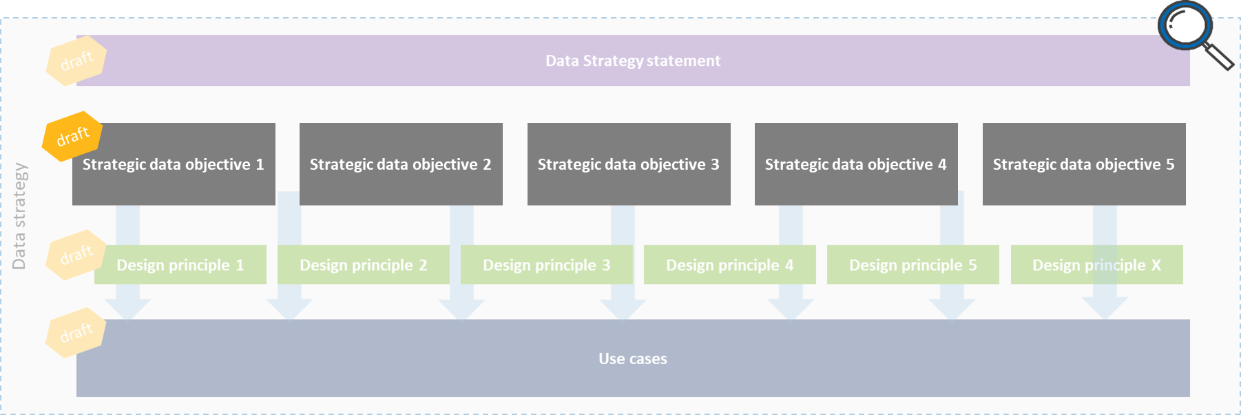
Strategic Data Objectives

Slide 10







Strategic Data Objective 1: Improving Data Governance and integrating Data Management into our business for ensuring regulatory compliance and easy/timely access to data
Strategic data objective 1
Improving Data Governance and integrating Data Management into our business for ensuring regulatory compliance and easy/timely access to data
Owner (s)
Description
Organizational Requirements
CDO, data management office
Consulted: data owners
Properly define and implement data management enablers such as data governance, data lineage, data quality and data life cycle management to improve compliance to e.g. SFDR, Solvency II and GDPR; automate where possible
Aligning the governance and collaboration between the enabling and controlling functions such as data, privacy, security, compliance and legal
Understanding the current state of the data operations, dataflows and ownerships
Identify executive sponsorship
Standardized data roles and responsibilities across the enterprise
Global data management processes to monitor data consumption, data quality and data life cycle
Common language across regions for products and client types
Partnering with business
Provide sufficient training and education to relevant resources to increase Data (Management) literacy and awareness level
Required
budget
Data Foundation Requirements
Data management tools and enablers to be built/matured/implemented
Key Use Cases
Timing & Dependencies
Estimated effort & resources
Assess which data management artifacts with which level of detail are necessary to support the data strategy and to enable appropriate control
Data Management maturity assessment and based on results revisit, update and document the current state data management processes, data governance charter and roles & responsibilities in order to improve
Define and document data lineage accordingly
Set up data delivery agreements between sharing/receiving parties
Align governance and supporting processes with security, privacy, compliance and legal
Re-launch data governance throughout the global organization based on revisited documents (focus on partnering with business)
Assess implementation of data management capabilities for compliance (e.g. SFDR, Solvency II and GDPR), implement and leverage on improved data management capabilities
Execute the use cases in given sequential order (not in parallel)
Data Governors
Retention & deletion of personnel data/GDPR
Populate after specifying use cases

Slide 11
Strategic Data Objective 2: Integration of data requirements in one enterprise data model across current and future demands to better serve our clients
Strategic data objective 2
Integration of data requirements in one enterprise data model across current and future demands to better serve our clients
Owner (s)
Description
Organizational Requirements
CAO, COO, CDO
Aspiration to build a global enterprise data model for all data domains unifying and communalizing the data requirements across the business lines and operations
Data requirements should be built based on current as well as future operational, client and regulatory demands which can be served by either internal or external data
Establish demand management process for future data requirements
Identify executive sponsorship
Global processes to simplify and standardize the way of working across regions
Global data owners per data domain
Required
budget
Data Foundation Requirements
Shifting from solution to enterprise architecture aligning IT programs and information assets with business strategy
Define the data architecture and a single source of truth per data domain
Re-platforming, automated data ingestion and integration/processing
Key Use Cases
Timing & Dependencies
Estimated effort & resources
Gather data requirements per business line to communalize and unify the supply and use of external data
Build global enterprise data model organized per data domain (Finance and HR are already completed?)
Build out the demand management for future data requirements by for example establishing a ticket system/backlog
Raft/Blackrock ADC (snowflake): 3 WAVE initiatives for US, EU FO & R, EU implementation
#1662 - Client master and segmentation
#1664 - Create Global product master (single data set) for all product based information [IT Demand]
Data integration architecture
Populate after specifying use cases

Slide 12

Strategic Data Objective 3: Global and consistent reporting for operational management and using data to run the firm by underpinning all decision-making
Strategic data objective 3
Global and consistent reporting for operational management and using data to run the firm by underpinning all decision-making
Owner (s)
Description
Organizational Requirements
CDO, COO, Global Reporting team, Global Research and insight team
Evolve from management by gut feel to data driven decision making by building global and consistent reporting capabilities to derive consistent, structured and high-quality understanding on what happens on daily basis incl. risks and opportunities
Standardize operational reporting on global level to drive the same insights with descriptive analytics while allowing each line of business to customize for their own needs
Put operational metrics and key performance indicators in place and use them to drive our strategy on a business line as well as on a global level
Develop ability to quickly respond to RfPs based on operational data and reporting being in place
Identify executive sponsorship
Global reporting process, rhythm and global KPI’s/metrics
Provide sufficient training and education to relevant resources to increase Reporting/Dashboarding literacy and awareness level
Required
budget
Data Foundation Requirements
See also strategic data objective #1 and #2
Single source of truth per data domain and unified reporting requirements across regions
Ongoing in-flight use cases
Key Use Cases
Timing & Dependencies
Estimated effort & resources
Measuring success – Financial metrics
Measuring success – Sales metrics
Define global (and business line) KPI’s based on reporting requirements gathered and translate them into use cases to be put on a roadmap for development
Define a process for other use cases that can be used for the RfP team
Define global reporting processes
Build dashboards for operational reporting
Measuring success – Financial metrics
Measuring success – Sales metrics
Global scheduling capabilities
Streamlining data sources for closing process
Enhancing the data/programming platform
#1156 - [IT Demand] MVP TO: Project Tetris (On train development work may be required to replace / transform any current NT data feeds to the new preferred supplier.)
Populate after specifying use cases
3
3
Global research and insight strategy
1
Commercial strategy & analytics to identify opportunities
2
Eliminate manual work
3
Measuring success
O
Other

Slide 13
WIP
Strategic Data Objective 4: Building a global way of working in enabling the business to use analytics and data innovation techniques to improve investment decisions and client experience
Strategic data objective 4
Building a global way of working in enabling the business to use analytics and data innovation techniques to improve investment decisions and client experience
Owner (s)
Description
Organizational Requirements
CDO, CTO, Global research and insight teams
Facilitate an aspirational environment to further encourage using data for forward-looking analyses, realizing our commercial strategy of identifying prospective clients and opportunities to strategically position Aegon AM in new markets, eliminate manual work and measure success
Understanding our clients needs, goals and their financial landscape
Establish an analytics way of working including the relevant governance and (technology) enablers
Enable automated real-time data feed for investment performance measurement to ensure consistent and correct advice and insights to clients
Consolidation of the pockets of information in client reporting via BI dashboards to keep up with the industry standards
Identify executive sponsorship
Formalize a global analytics way of working to accelerate the way from ideas to analytics
Integrate analytics way of working in organizational and data governance and assign model/product ownership rules
Have enough resources in the Global Insights and other analytics teams
Provide sufficient training and education to relevant resources to increase Analytics literacy and awareness level
Have communication and awareness sessions about analytics possibilities
Set up stage that IT does not need to be involved for client reporting; reduce manual labor, data minded/savvy employees
1
2
3
Required
budget
Data Foundation Requirements
Re-platforming, automated data ingestion and integration/processing
Have the supporting (data) architecture for analytics purposes
Include security check fields in combining internal and external data
Ongoing in-flight use cases
Foundational use cases
Timing & Dependencies
Estimated effort & resources
Distribution screen to identify future opportunities
Anticipate replacement opportunities
Mandate releases mail
Automate production and distribution of the mandate Opps email
Actionable intelligence pushed to CRM for sales, consultant relations, and client service teams
Assess which artifacts are necessary to build out usage of data & analytics throughout the organization (architectural capabilities such as tools, etc.)
Establish an analytics way of working including the relevant governance and enablers
Build self-service information products for clients
#1661 - [Analytics] Global Client Group Analytics Retirement program
#96175 - [NL Retirement] Create a data driven infrastructure to support increasing client needs for customized information
Use of RPA
#46874 - Global insights framework
Concluding IG/HY research split
Enhancing RI research methods
Implementing Aladdin Research
#2180 - Impact Venture Credit investment strategy (?)
Populate after specifying use cases
1
1
2
3
1
1
2
1
2
3
2
2
Global research and insight strategy
1
Commercial strategy & analytics to identify opportunities
2
Eliminate manual work
3
Measuring success
O
Other

Slide 14





WIP
Key use cases linked to Objective 4 (1/2)
Strategic data objective 4
Building a global way of working in enabling the business to use analytics and data innovation techniques to improve investment decisions and client experience
Key Use Cases
Assess which artifacts are necessary to build out usage of data & analytics throughout the organization (architectural capabilities such as tools, etc.)
Establish an analytics way of working including the relevant governance and enablers
Build self-service information products for clients
Real assets US (still on SQL DB) – out of scope, first to re-platform
O
Use demographic data
Specify underwriting strategies
Impact of climate change/carbon reduction
Data at macro & asset level
1
2
3
1
2
3
2
Portfolio management
Alternative fixed income
Automation of performance calculations
Understand what impact (performance in general and ESG) AAM is making to be prepared for the asks of the clients and society
Trend analysis
Robo investment
Front/middle office activities:
To constantly renew data for investment processes
What information you derive from clients to provide right suggestions/proposals?
Prospects/market analysis to target most likely prospects
Combine daily positions with ESG data, play around with different matrix: risk and return & ESG
Integrate analytics (of internal and external data) in investment process to improve performance management and use it as a marketing tool
Need more data on ESG
2
3
1
O
1
Fixed income
2
Automate principles of investment process to track out of sample results and inform a fundamental (or "quantamental") research process
Algorithms to buy/sell + meta-algorithms to evaluate effectiveness/timing/costs of made decisions
Review different indicators and their impact on markets
Need more benchmarking information
Hire data scientists and look for alternative data providers
2
2
1
2
1
1
1
1
Equities
O
Analyze investment universes on the basis of financial and non-financial data to construct portfolios that meet your clients' risk return requirements, regulatory restrictions and ESG preferences
1
Global research and insight strategy
1
Commercial strategy & analytics to identify opportunities
2
Eliminate manual work
3
Measuring success
O
Other

Slide 15




WIP
Key use cases linked to Objective 4 (2/2)
Strategic data objective 4
Building a global way of working in enabling the business to use analytics and data innovation techniques to improve investment decisions and client experience
Key Use Cases
Distribution/product incl. Client Group:
Human Resources
O
Track funds and sales
Track clients performance
Create standardized BI dashboards for client reporting across all asset classes
Current use case: Opportunities and sales activities tracking
More analytics/forecasting on what is going to happen/turnover for leaders
Understand what is driving people/how to drive behavior & performance
Systems for employee experience
3
3
1
1
Finance
Marketing
Automation/use more technology to get data from global data model to reports to provide insights to mgmt.
Use more visualization/PowerBI/more user friendly
Automate manual forecasts, use predictive analytics
AuM, personnel data, performance data, portfolio characteristics and portfolio attribution
Automate update of factsheets and presentation on the website -> good for sales & RFPs; Focus more on advertising, Show trends to sales team, Thought leadership & Individual campaigns
Prospects/market analysis; What products are hot? Which industries/type of clients?
Cross sell/suggestions for new buying decisions
Prepare sales with social media data
2
O
O
2
2
1
1
1
Global research and insight strategy
1
Commercial strategy & analytics to identify opportunities
2
Eliminate manual work
3
Measuring success
O
Other

Slide 16
Strategic Data Objective 5: AAM as user of data-driven technologies to become the preferred Responsible Investment provider
Strategic data objective 5
AAM as user of data-driven technologies to become the preferred Responsible Investment provider
Owner (s)
Description
Organizational Requirements
CDO, COO, CIOs, Head of Responsible Investment
Build Responsible Investment data approach in line with AAM’s business strategy, Aegon Groups ESG strategy, regulatory requirements and determine the role of the internal and external ESG data in it
Leverage improved data management capabilities for ESG data
Professionalize enterprise wide ESG rating methodology across regions that is taking into account clients’ needs and asks (per investment platform, per asset class and per investor objective)
Identify executive sponsorship
Build standardized processes to work with ESG data across all regions
Provide training and education on ESG data methodology to front office to ensure using the same language while advising to clients
Provide training and education to the back office to ensure data management/governance processes are integrated into the ESG approach
Required
budget
Data Foundation Requirements
Centralize ESG data to create trusted sources of truth (& golden source for carbon data)
Build ESG data quality checks secured within corporate ESG policy
Document ESG business terms, business rules, data lineage and transformations in a central business glossary (e.g. Collibra)
Key Use Cases
Timing & Dependencies
Estimated effort & resources
Collect input from clients and business units on ESG (reporting) needs
Determine AAM enterprise-wide ESG methodology (per investment platform, per asset class and per investor objective) to take into account while making investment decisions in order to be transparent to our clients
Develop capabilities to retrieve, review, store and maintain (un)structured external/internal ESG data
Standardize and automate operational ESG reporting (internal/global) and the regulatory ESG reporting (external/local)
Develop framework for commercial teams to standardize (external) ESG reporting for clients
Progress on data management capabilities as described in data objective 1
Mandate of Sustainability Board
#93557 - Climate Risk Assessment and Stress Testing/Scenario Analysis incl. carbon footprint monitoring and reporting
Populate after specifying use cases

Slide 17
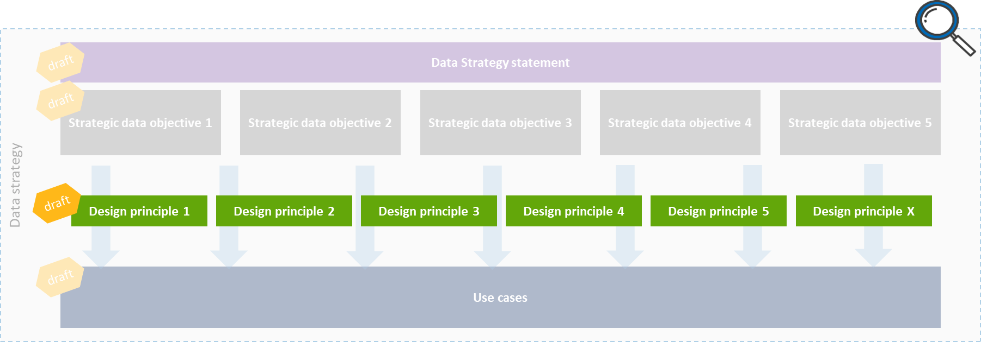
Data Design Principles

Slide 18


Overview of draft data (design) principles
Data (Design) principles
Data is at the heart of our business and we invest in the organizational and technological enablers to increase our AuM and improve operational excellence
We are a data enterprise with one global, integrated data model providing a unified information view to better serve our clients in everything we do
Clearly defined data domains
Common data definitions
We strive to keep data on visible core platforms and avoid EUC/shadow IT as much as possible
Our global data management framework provides data quality, privacy and compliance by design and ensures data is always shared in a secured manner
We are dedicated to embed the culture of ‘data ownership is a business responsibility’ and the data owner is always accountable for managing their data, identifying and describing their Critical Data Elements and control the data quality
Data quality is managed at the source (place where data is created by data producer)
We maintain a single entry point into the organization for external (purchased) data
All CDEs are documented, located in a golden source and understood commonly
We simplify and standardize our activities by automating data processing (calculate it once, use it by many) where possible in order to enhance first-time right (straight-through-processing) and therefore creating cost efficiencies
We facilitate and enable business driven analytics initiatives with a global way of working and architectural standards
A support model overseeing the day to day functioning (You build it, you support & maintain it)
Running costs to be covered by value added insights (Use it or lose it)
We apply a holistic approach to utilizing trusted ESG data & analytics to engage with our prospects and clients to enable them to make responsible investment decisions
Our ESG rating approach is clearly presented throughout portfolio management and client reporting
We structurally provide ESG data and (performance) insights to clients
Foundational data principle
Analytics aspiration principle

Slide 19



Data (Design) Principles (1/4)
#1
#2
Data is at the heart of our business and we invest in the organizational and technological enablers to increase our AuM and improve operational excellence
We are a data enterprise with one global, integrated data model providing a unified information view to better serve our clients in everything we do
Clearly defined data domains
Common data definitions
We strive to keep data on visible core platforms and avoid EUC/shadow IT as much as possible
Description
Focus Areas
Description
Focus Areas
AAM understands that data is critical and playing a key role to deliver its strategic business objectives by striving for data-driven decision-making throughout the whole organization not only for better investment management but also for improved operational efficiency across the full value chain. Investing in organizational and technical enablers will help us to optimize our distribution and service models, generate actionable client insights, enhance performance monitoring and set tangible global KPIs and metrics, automating manual processes and also to drive high-quality risk management.
Global KPIs and metrics
Global (reporting) processes in the middle and back office
Automated data ingestion
We strive for building a global data model with global business requirements collected and communalized for each business unit within clearly defined data domains and with the common definitions. AAM is aiming to store the data on core platforms, provide access to enterprise applications defined under the enterprise architecture.
Enterprise architecture
Data architecture and source per data domain
Directly linked strategic data objective
Directly linked strategic data objective
#2: Integration of data requirements in one enterprise data model across current and future demands to better serve our clients
#3: Global and unified Business Intelligence for operational management underpinning all decision-making
#4: Building a global way of working to enable the business to use analytics and data innovation techniques
#2: Integration of data requirements in one enterprise data model across current and future demands to better serve our clients
Foundational data principle
Analytics aspiration principle

Slide 20
Data (Design) Principles (2/4)
#3
#4
Our global data management framework provides data quality, privacy and compliance by design and ensures data is always shared in a secured manner
Data ownership is a business responsibility and the data owner is always accountable for data quality
Data quality is managed at the source (place where data is created by data producer)
We maintain a single entry point into the organization for external (purchased) data
Description
Focus Areas
Description
Focus Areas
The global AAM data management framework is the ultimate guideline to ensure all people have the right elements they need to provide accurate, consistent and complaint data to the business. Clearly defined data governance, data lineage and data life-cycle helps to implement data quality and data privacy, and therefore enhance the regulatory compliance.
Furthermore, we ensure all AAM employees are well-informed that data needs to be always shared via firm-wide secured channels.
Data management framework
Data transfer channels
Data producing business units are owning the data they produce and are accountable for the data quality. We have a centralized Data office team that is there to support the business in taking its responsibilities, complying with policies and driving through the market best practices while the data quality is managed and corrected at the source by the business pulling the data and produced it. The data is being leveraged as ‘firm asset’ and stored centrally and distributed decentrally and we integrate systems through a data hub and not directly from system to system.
Central data hub
Data governance processes at the source
Global data quality framework
Directly linked strategic data objective
Directly linked strategic data objective
#1 Improving Data Governance and integrating Data Management into our business for ensuring regulatory compliance and easy/timely access to data
#1 Improving Data Governance and integrating Data Management into our business for ensuring regulatory compliance and easy/timely access to data
#2: Integration of data requirements in one enterprise data model across current and future demands to better serve our clients
Foundational data principle
Analytics aspiration principle

Slide 21

Data (Design) Principles (3/4)
#5
#6
We simplify and standardize our activities by automating data processing (calculate it once, use it by many) where possible in order to enhance first-time right (straight-through-processing) and therefore creating cost efficiencies
We facilitate and enable business driven analytics initiatives with a global way of working and architectural standards
A support model overseeing the day to day functioning (You build it, you support & maintain it)
Running costs to be covered by value added insights (Use it or lose it)
Description
Focus Areas
Description
Focus Areas
We own simplified and standardized calculation models used across all regions that allows us to automating the processes and, therefore helping us to improve the first-time right results. In turn, we generate further headspace for creating high-value advanced analytics insights which ultimately positions our firm as an attractive employer for acquiring sophisticated talents and retaining the high-potential resources.
Process automation
Advanced analytics insights
Talent acquisition and retention
We recognize that analytics is a team sport and its success is dependent on efficient and effective cross-functional skills (e.g. business, data, technology, operations, compliance). As a result, AAM is dedicated to build a global way of working to support the analytics initiatives facilitated by a guided communications and the relevant governance to ensure the involvement of business partners. The business and the analytics teams work together throughout development as well as the day to day functioning of the initiaves including maintenance to ensure the opportunity costs are compensated with the created added value.
Global analytics ways of working
Client reporting (BI dashboards)
Automation of investment processes
Directly linked strategic data objective
Directly linked strategic data objective
#4 Building a global way of working to enable the business to use analytics and data innovation techniques
#4 Building a global way of working to enable the business to use analytics and data innovation techniques
Foundational data principle
Analytics aspiration principle

Slide 22
Data (Design) Principles (4/4)
#7
We apply a holistic approach to utilizing trusted ESG data & analytics to engage with our prospects and clients to enable them to make responsible investment decisions
Our ESG rating approach is clearly presented throughout portfolio management and client reporting
We structurally provide ESG data and (performance) insights to clients
Description
Focus Areas
Our clients are a part of our ESG story and we make sure that they understand the ESG goals we are committed to achieve with our three strategic pillars – ESG integration, active ownership and solutions - by providing them access to ESG data & analytics in our client reporting. As an integral part of our investment decisions, we enable our clients to understand the material impact/contribution of their investments as well as how we calculate and monitor this impact.
Client reporting
ESG rating/categorization approach
Structured ESG data
Directly linked strategic data objective
#5 AAM as user of data-driven technologies to become the preferred Responsible Investment provider
Foundational data principle
Analytics aspiration principle

Slide 23

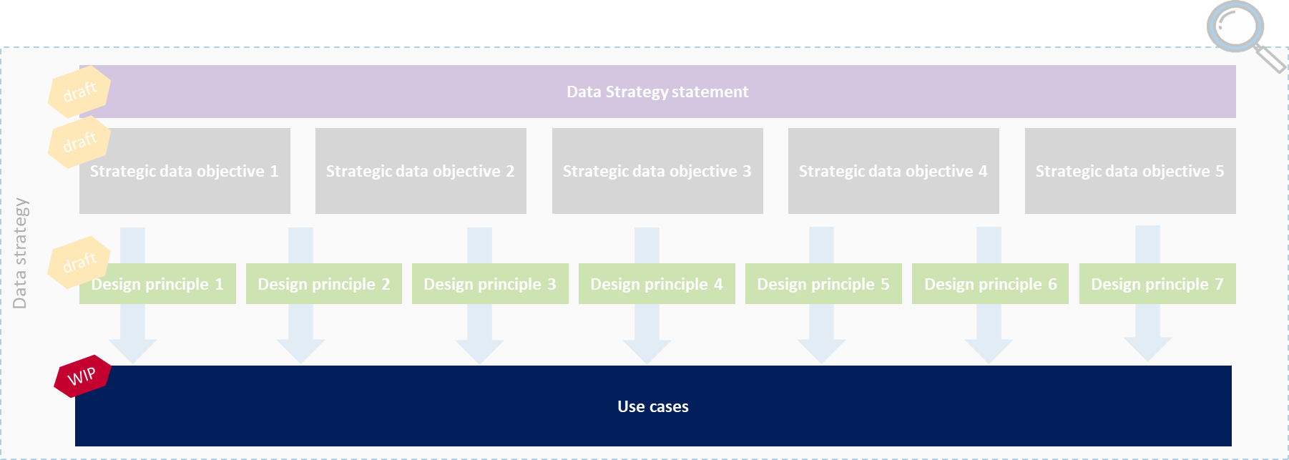
Key Use Cases
WIP

Slide 24
Use Cases for Data Objective 1 (1/4)
Strategic data objective 1
Improving Data Governance and integrating Data Management into our business for ensuring regulatory compliance and easy/timely access to data
Data Management (DM) artifacts
Assess which data management artifacts with which level of detail are necessary to support the data strategy and to enable appropriate control
DM Assessment & update current processes
Data Management maturity assessment and based on results revisit, update and document the current state data management processes, data governance charter and roles & responsibilities in order to improve
Defensive
Impact
Defensive
Impact
Understanding the requirements of the data strategy for DM artifacts
All Areas/BUs impacted
Alignment of requirements from security, privacy and compliance
All Areas impacted
Better understanding of the gaps in the current processes and roles and responsibilities
Improved data management governance in line with key goals
Ease of implementation
Ease of implementation
Capture data management, privacy and compliance requirements for the data strategy realization (1-2 days)
Organize multiple working sessions with the owners of the strategic data objectives and data management experts to identify the necessary artifacts (owners invest 1-2 days)
Prepare workshops and document outputs (2 Data Office members invest 5 days)
Total of 4-6 weeks effort required
Available documentation on data management and data governance charter required
Documentation on definitions of current roles and responsibilities required
Organize a couple of workshops to deep-dive on the data management capabilities with stakeholders across the organization
Total of 4-6 weeks effort required
Use case heatmap
Use case heatmap
H
H
M
M
Impact
Impact
L
L
L
M
H
L
M
H
Ease of implementation
(effort level)
Ease of implementation

Slide 25
Use Cases for Data Objective 1 (2/4)
Strategic data objective 1
Improving Data Governance and integrating Data Management into our business for ensuring regulatory compliance and easy/timely access to data
Defining data lineage
Document and define data lineage
Introducing DDAs
Set up data delivery agreements (DDA) between sharing/receiving parties
Defensive
Impact
Defensive
Impact
All Areas impacted
Improved visibility of data flows
Large improvement in data quality
All Areas impacted
More efficient, controlled and compliant data sharing and data usage
Ease of implementation
Ease of implementation
Reviewing the data movements in Collibra
Understanding the (if any) gaps in the data flows and tracking its sources
Identification of level of depth expected in data flows
Align with/benefit from RAFT documentation
Subject matter experts from BUs need to be available
Significant effort from data team required
Creating a standardized DDA template for all BUs to use and make custom changes where necessary
Define scope/applicability of DDAs
Train users for the usage of DDAs
Collaboration between data team and relevant BUs required to set up and agree on DDAs
Total of 4-6 weeks effort required
Use case heatmap
Use case heatmap
H
H
M
M
Impact
Impact
L
L
L
M
H
L
M
H
Ease of implementation
Ease of implementation

Slide 26
Use Cases for Data Objective 1 (3/4)
Strategic data objective 1
Improving Data Governance and integrating Data Management into our business for ensuring regulatory compliance and easy/timely access to data
Aligning governance and support processes
Align governance and supporting processes with security, privacy, compliance and legal
Relaunch data governance
Re-launch data governance throughout the global organization based on revisited documents (focus on partnering with business)
Defensive
Impact
Defensive
Impact
All Areas and BUs impacted
Minimizing data risks and possible fines by aligning regulatory data requirements from different angles
Large improvements in compliance, security and privacy
All Areas and BUs impacted
Large improvement in data ownership
Large improvement in trust to data
Ease of implementation
Ease of implementation
Build collaboration between supporting/ controlling data functions with team leads
Embed defined data management artifacts into the other processes
Organize ongoing alignment between functions
Alignment between team leads needs limited resources
Required number of resources for implementation tbd
A global data governance program including the milestones, deliverables and the project management team is required based on use case nr. 1 and 2
Required number of resources to be added when plan is specified
Use case heatmap
Use case heatmap
H
H
M
M
Impact
Impact
L
L
L
M
H
L
M
H
Ease of implementation
Ease of implementation

Slide 27
Use Cases for Data Objective 1 (4/4)
Strategic data objective 1
Improving Data Governance and integrating Data Management into our business for ensuring regulatory compliance and easy/timely access to data
Improving data management for compliance
Assess implementation of data management capabilities for compliance (e.g. SFDR, Solvency II and GDPR), implement and leverage on improved data management capabilities
Defensive
Impact
All areas and Bus
Strengthening defensive capabilities to ensure there are no regulatory issues and AAM conforms to Group policies
Large improvement of the firm-wide implementation of data management capabilities to ensure compliance
Ease of implementation
Understanding the different compliance data requirements
Understand the current way of managing regulatory data and the gap to the requirements
Need medium involvement of a combination of data office, Risk, Compliance, data governance community and a number of SME’s
Use case heatmap
H
M
Impact
L
L
M
H
Ease of implementation

Slide 28

Next Steps

Slide 29
Next steps
Working sessions to specify Use Cases
Data foundation with Carrie Olmstead & Steve Harker (TBS)
Analytics with Stuart Donald & team (22/2, 24/2 + 28/2)
TBD
SteerCo III
10 March
Final Data strategy will be presented for approval and sign-off incl. follow up actions
Determine data strategy lead + executive sponsor
Define data strategy implementation plan and program set up
01
03
05
Knowledge sharing session
7 March
The objective of the session is to provide external insights on the use of data and priorities in the asset management sector
Leadership update with Bas
15 March
Provide an overview of the data strategy and trends to Bas
02
04

